Slide 1
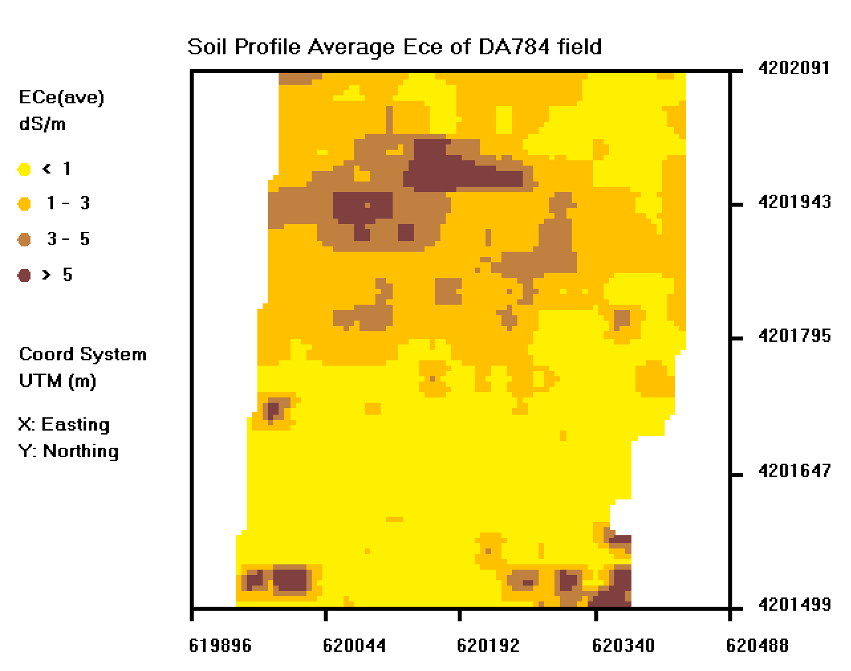
Using ESAP-Calibrate and ESAP-SaltMapper
How to create effective calibrations of EMI readings to other soil characteristics

Slide 2
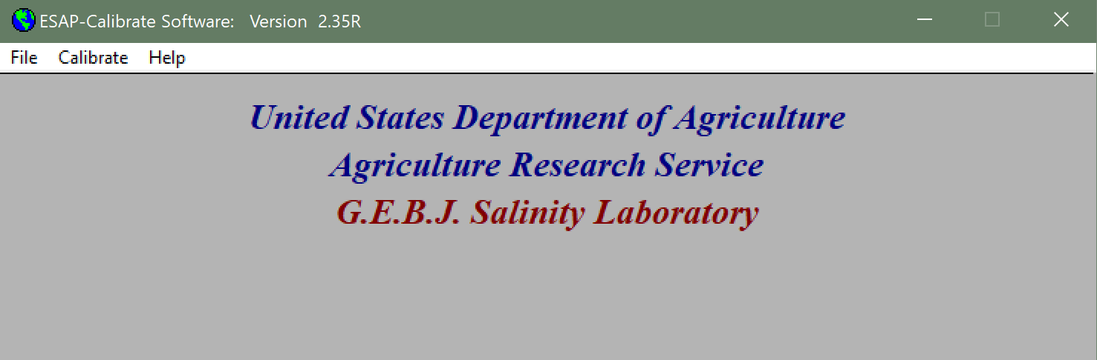
Open ESAP-Calibrate from the main ESAP menu

Slide 3
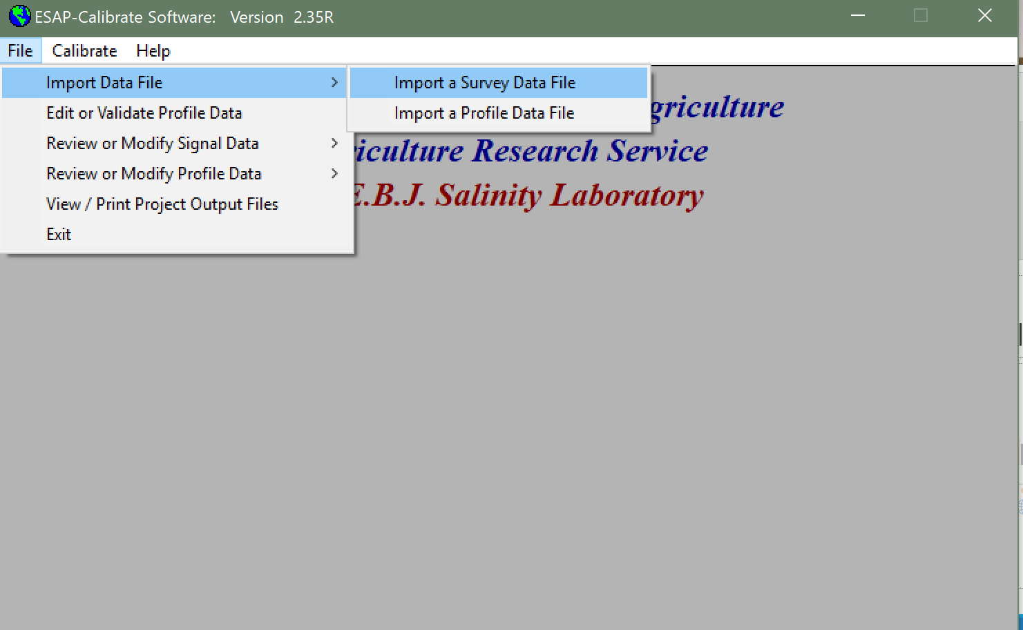
Import Survey Data File

Slide 4
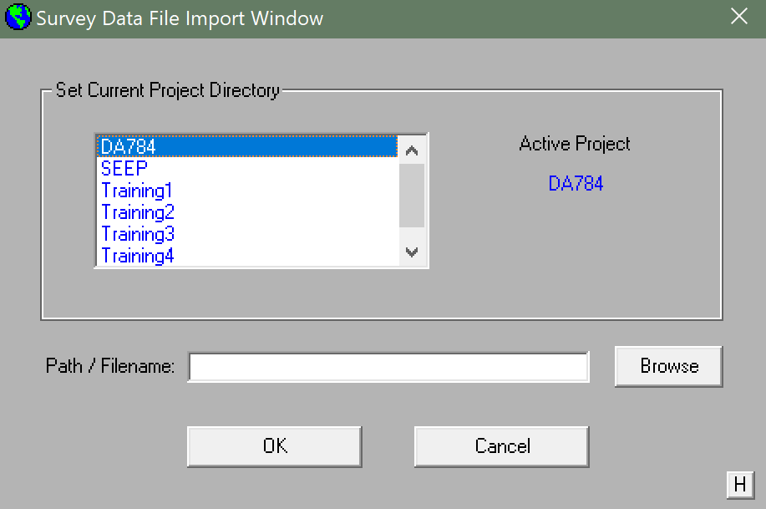
Import .svy file generated from ESAP-RSSD

Slide 5
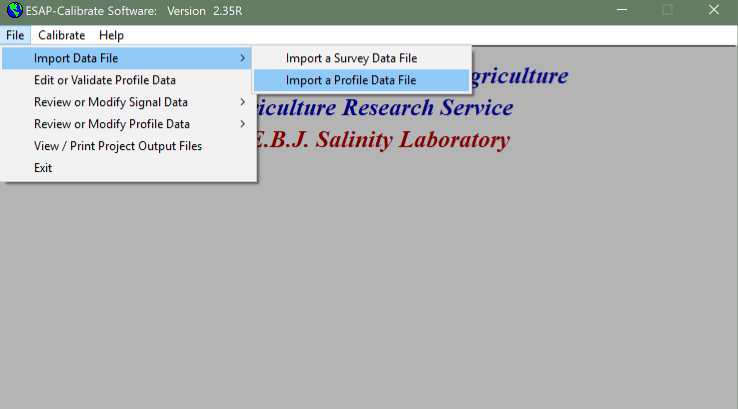
Create New Profile Data File

Slide 6
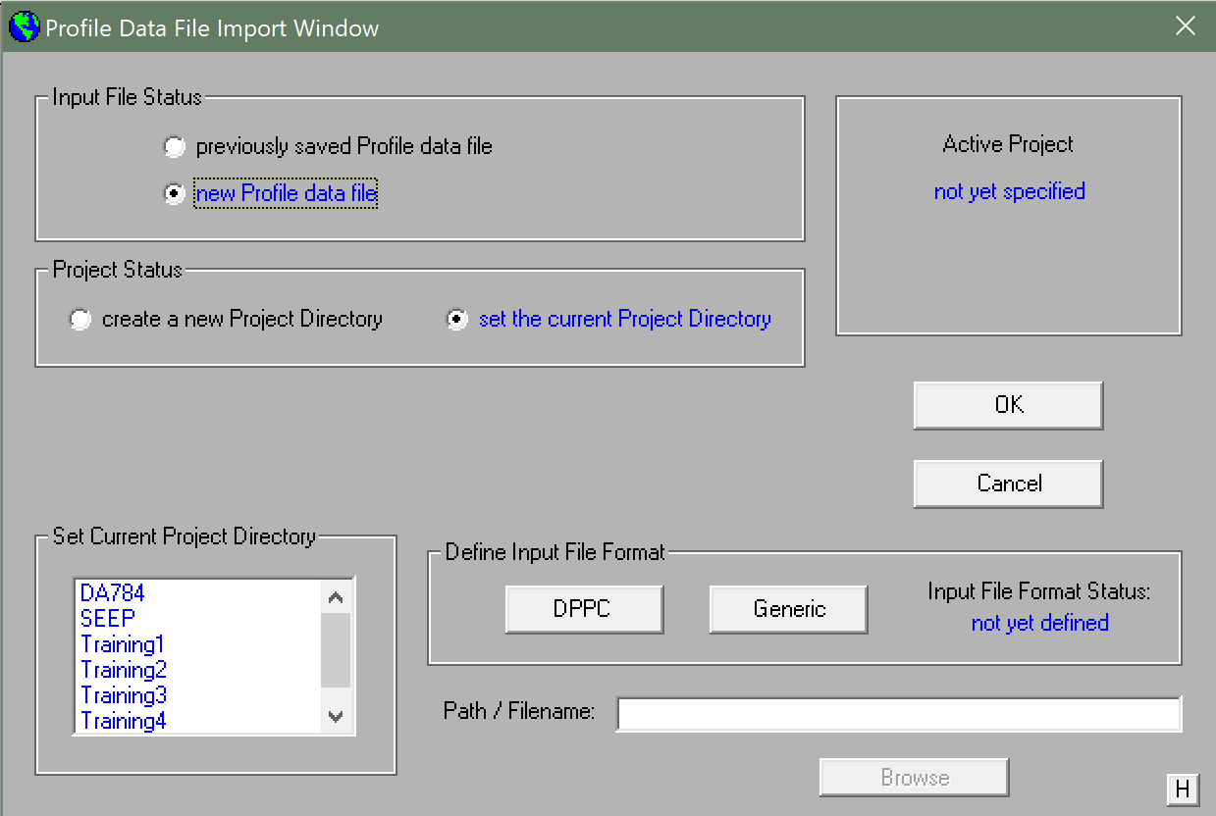
Input Lab Data as .csv in correct format. Under “Data Input File Format” click “Generic”

Slide 7
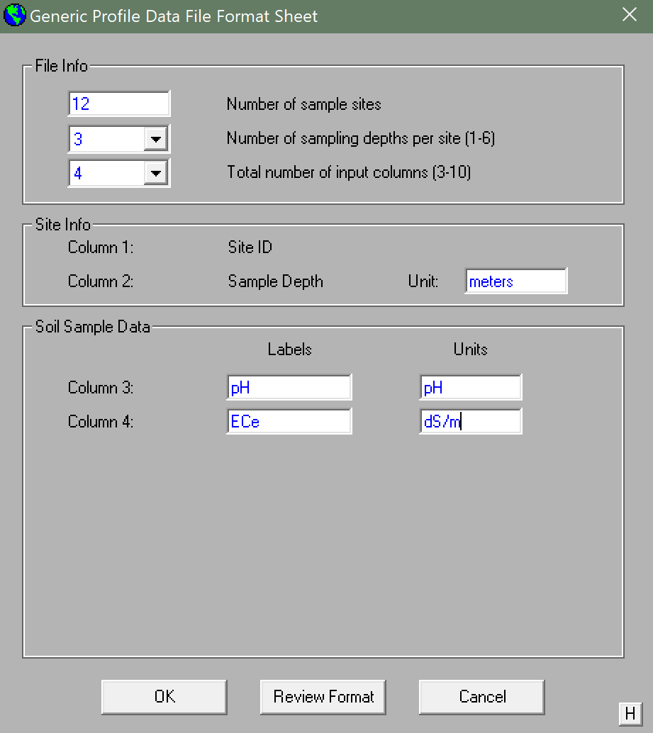
Fill in boxes with appropriate values and press “OK”

Slide 8
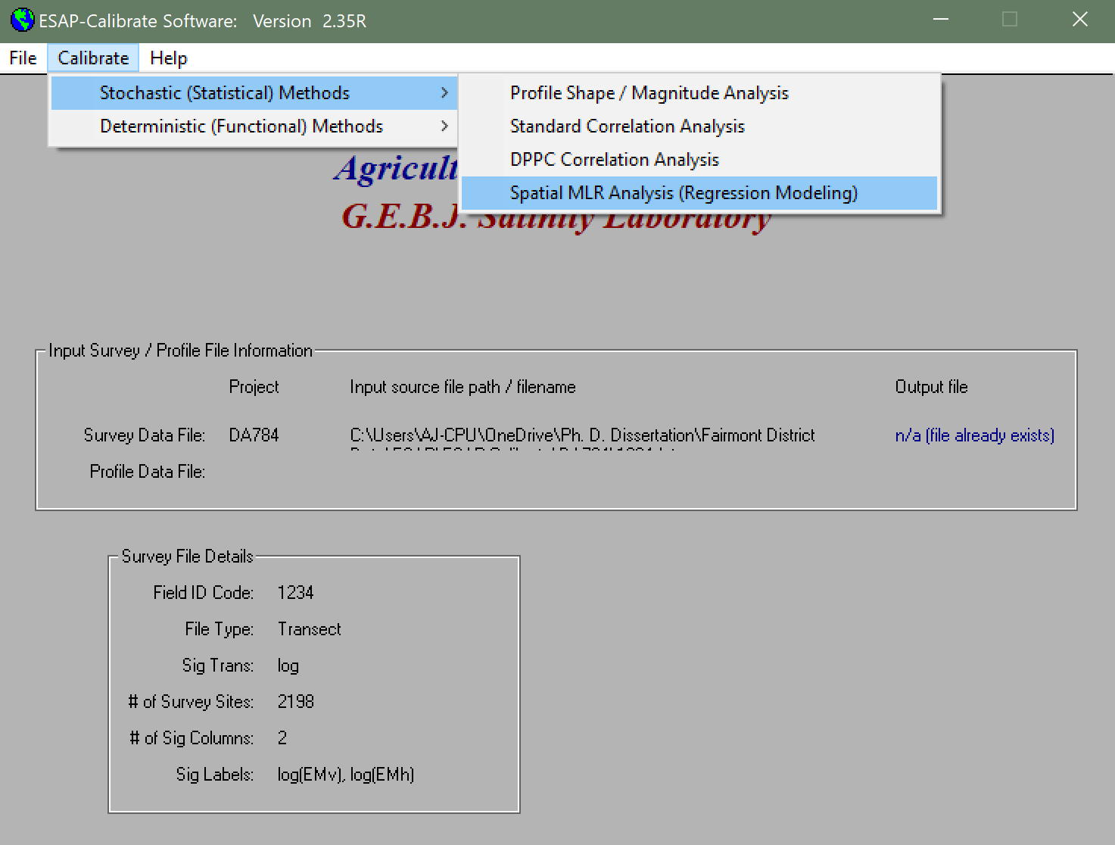
At the main menu, go to the Regression Modelling module

Slide 9
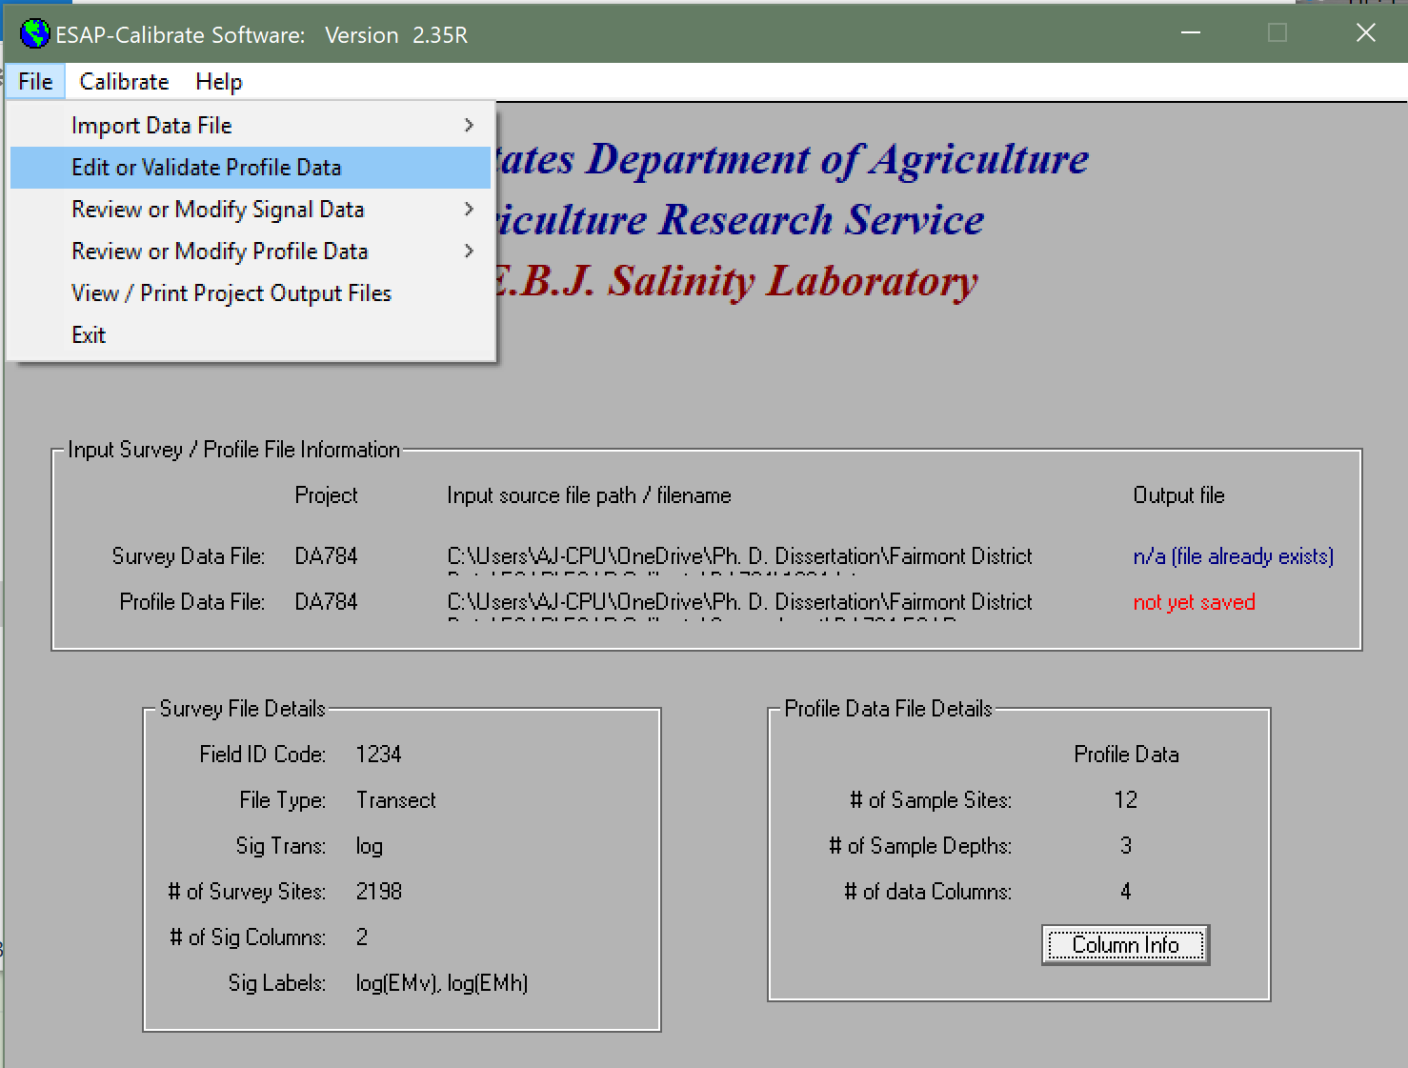
At the menu under “File” go to “Edit of Validate Profile Data”

Slide 10
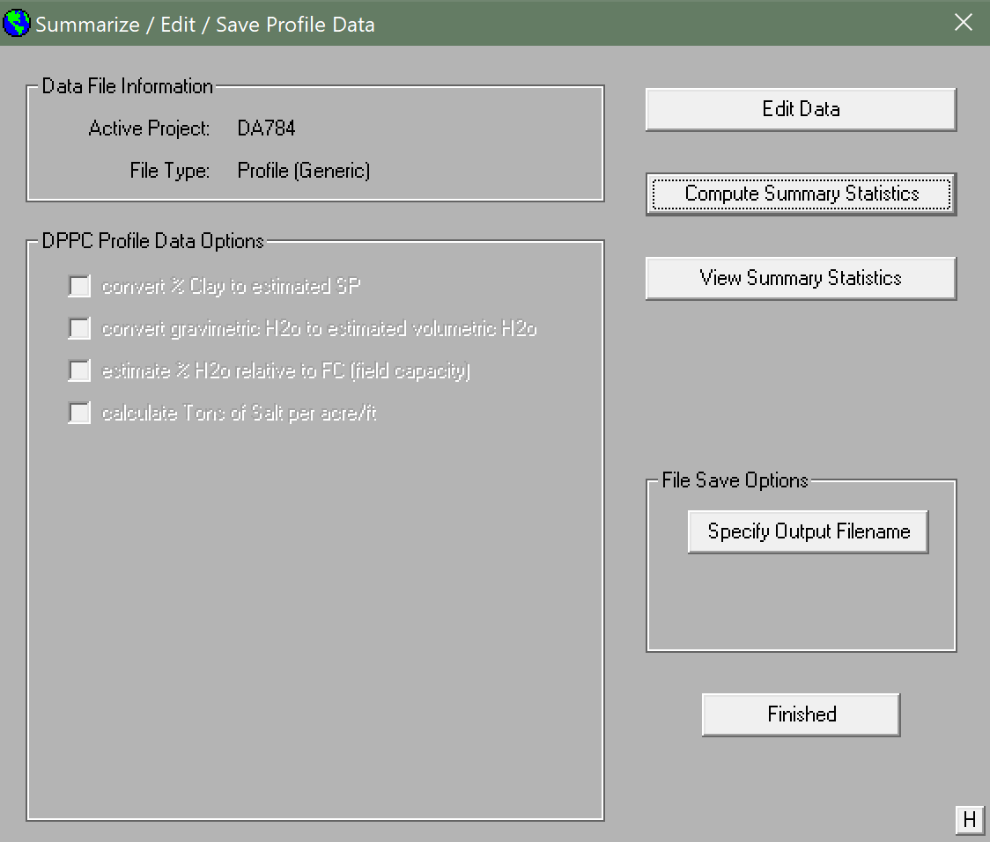
Compute summary statistics, then save your results

Slide 11
At the main menu, go to the Regression Modelling module

Slide 12
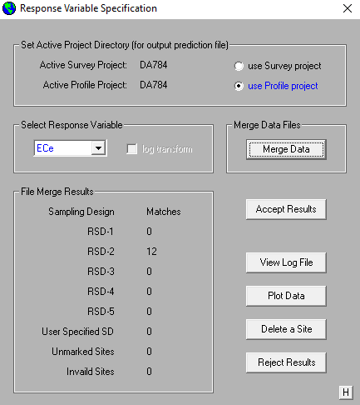
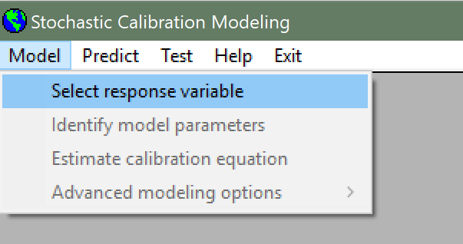
Select Response Variable and Merge Data. Accept Results.

Slide 13
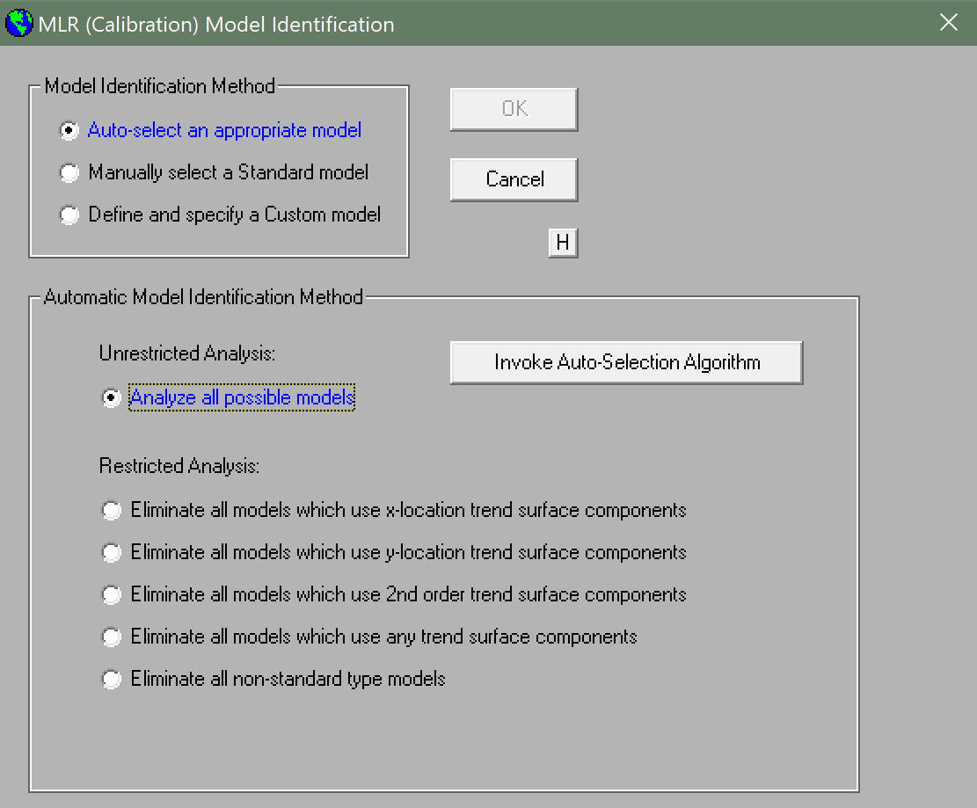
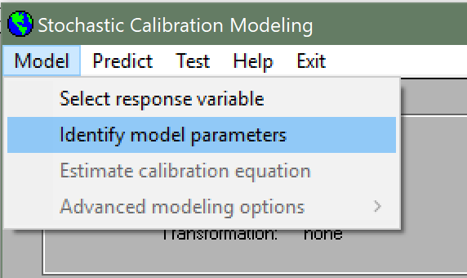
“Model” → “Identify model parameters” → “Auto-Select an appropriate model” → “Analyze all possible models” → Invoke

Slide 14
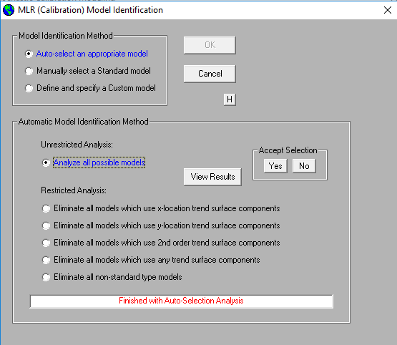
View Results (optional) to obtain PRESS score rankings, and then accept selection

Slide 15
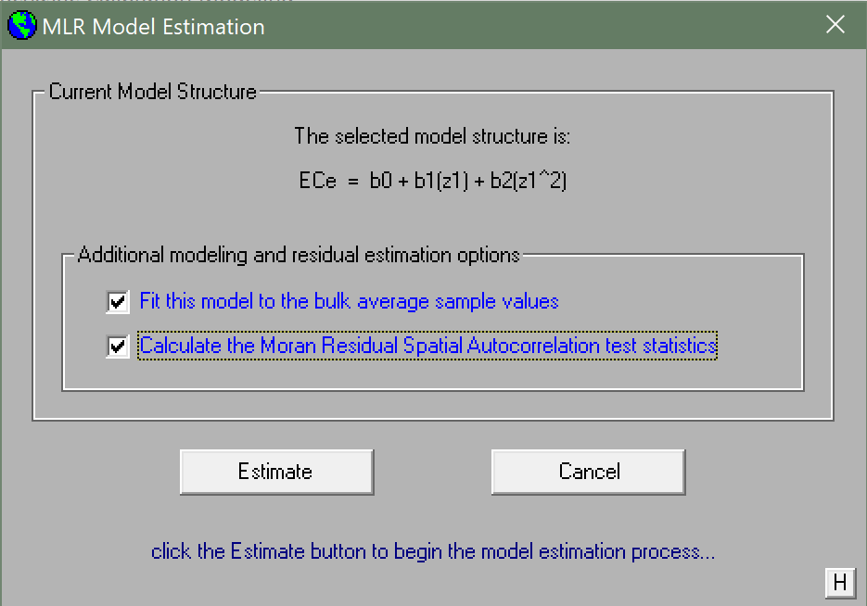
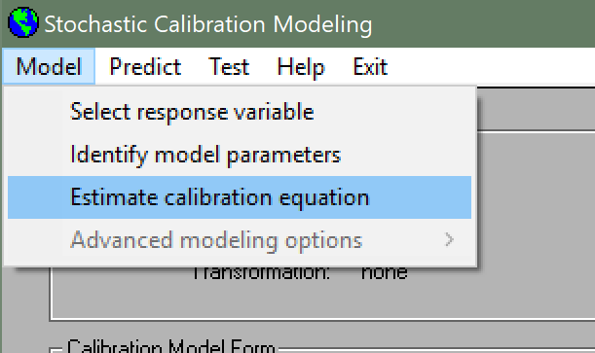
“Model” → “Estimate calibration equation” → Check both boxes→ “Estimate”

Slide 16
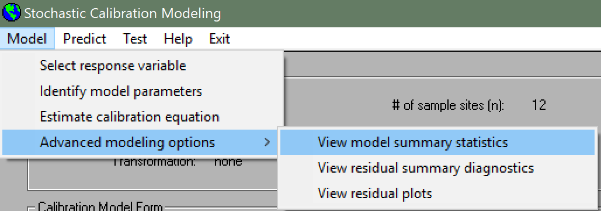
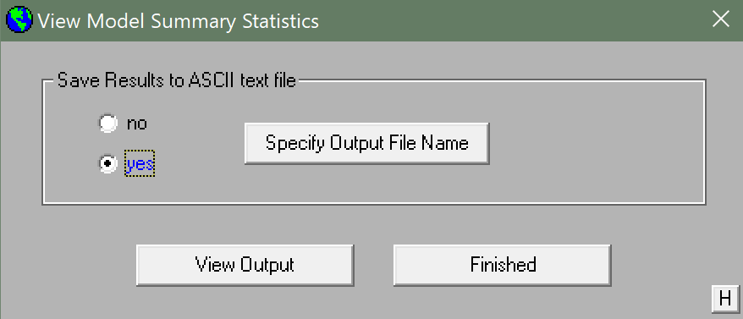
“Model” → “Advanced modeling options” → “View model summary statistics” → “Specify Output File Name” → “Finished”
THIS FILE HAS THE REGRESSION EQUATION COEFFICIENTS FOR EACH DEPTH AND AVERAGE

Slide 17
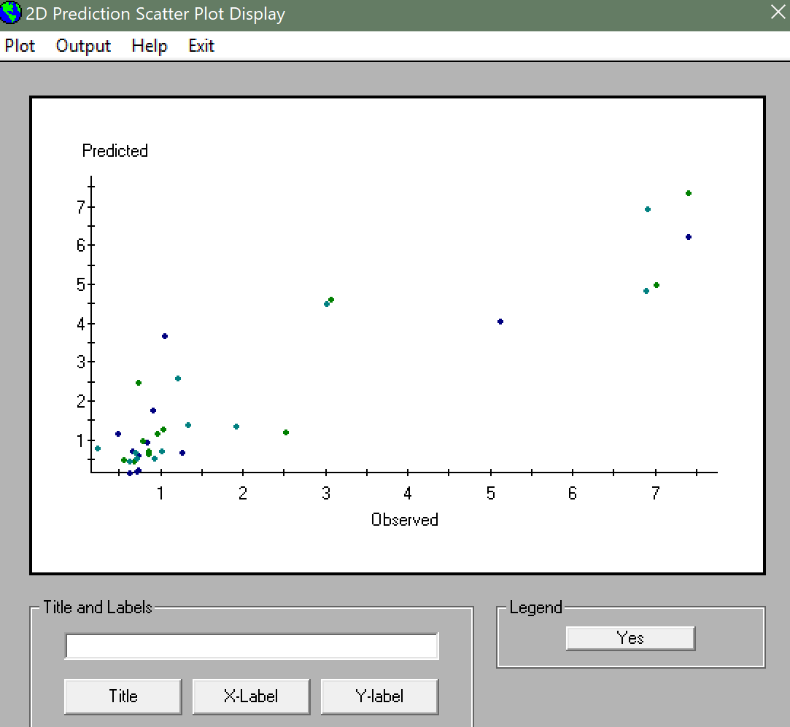
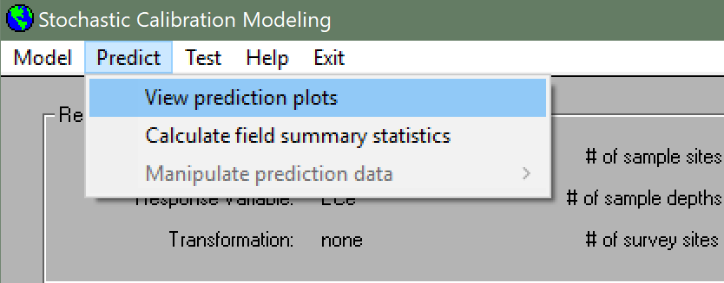
Optional: View prediction plots for accuracy

Slide 18
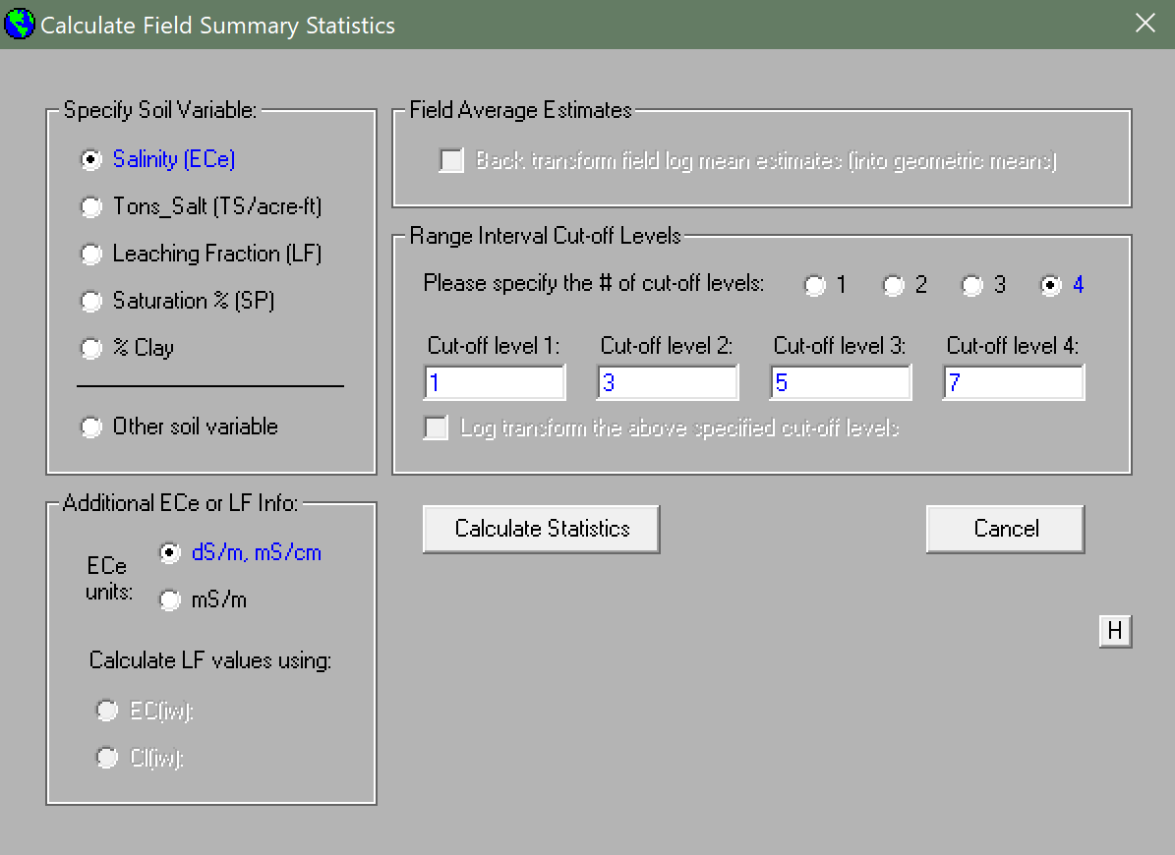
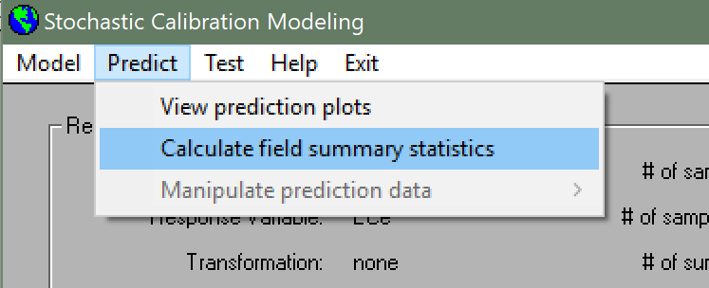
“Predict” → “Calculate field summary statistics” → Specify Soil Variable → Specify Cut-off values → “Calculate Statistics”

Slide 19
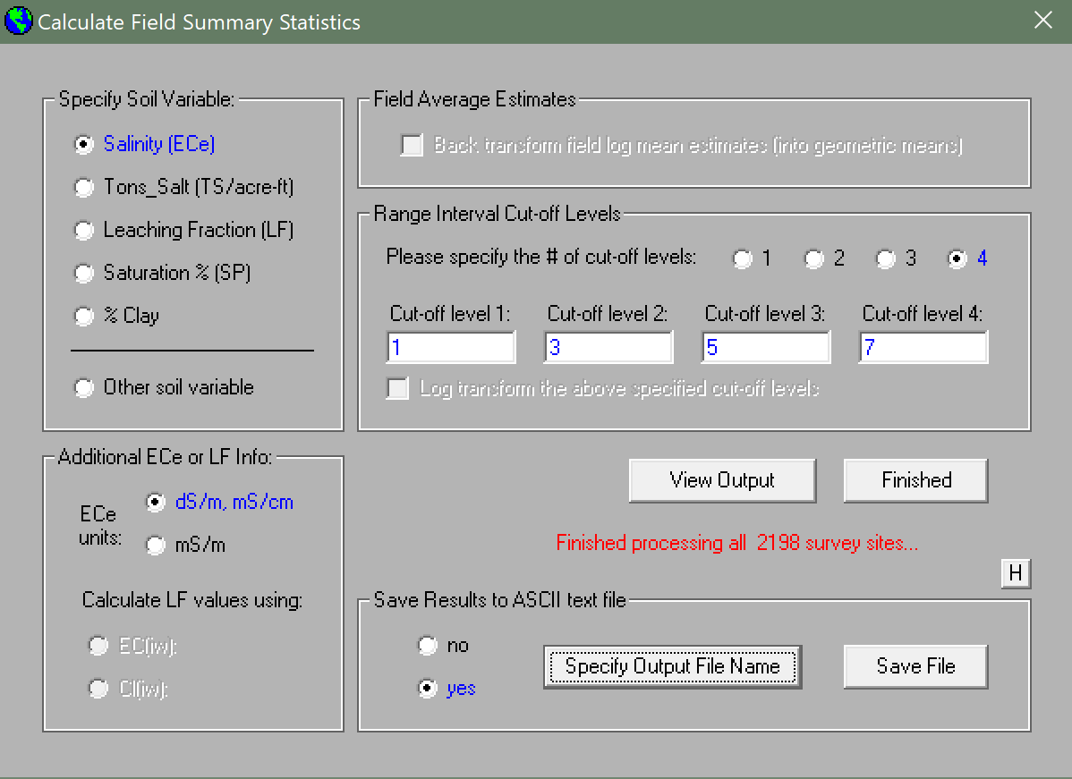
Specify Output File Name → Save File → Finished

Slide 20
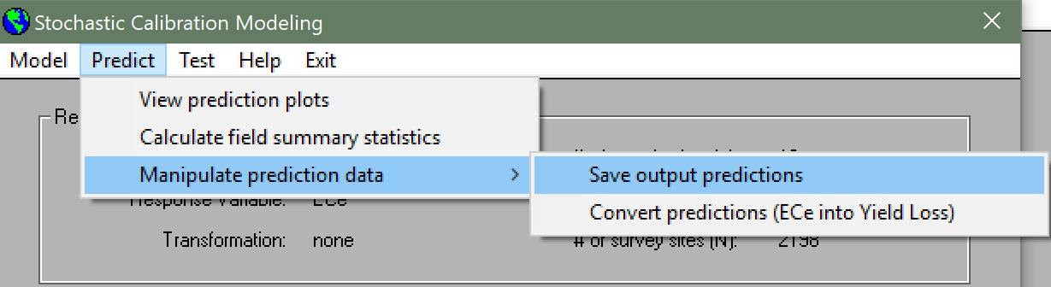
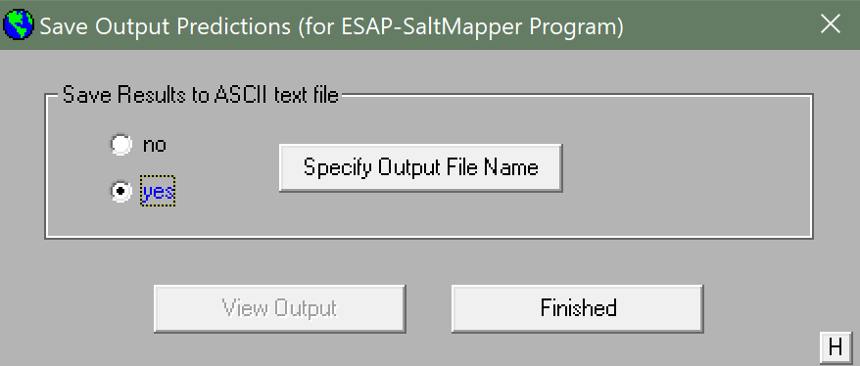
“Predict” → “Manipulate prediction data” → “Save output Predictions” → “Specify output file name” → “Finished”

Slide 21

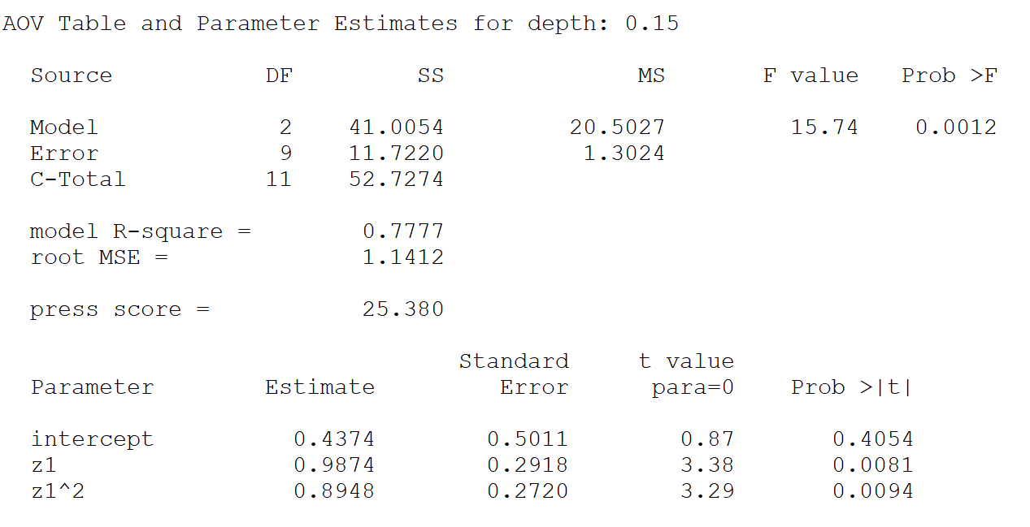
Calibration is Now Complete!
Additional options from here:
Yield loss predictions
Mean-Shift Tests to see if salt content in a field has changed from one EM38 survey to another
Net-Flux tests to see if salt content in a single sample site location has changed via additional soil samples
To view calibration equations directly:
Find the project folder in the file explorer and open the file created in slide 16. An example of an equation is shown

Slide 22
The ESAP-Calibrate Predictions are Now Ready for Use for ESAP-SaltMapper

Slide 23
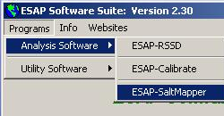
Select ESAP-SaltMapper from the “Programs” and “Analysis Software” menus.

Slide 24
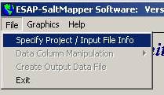
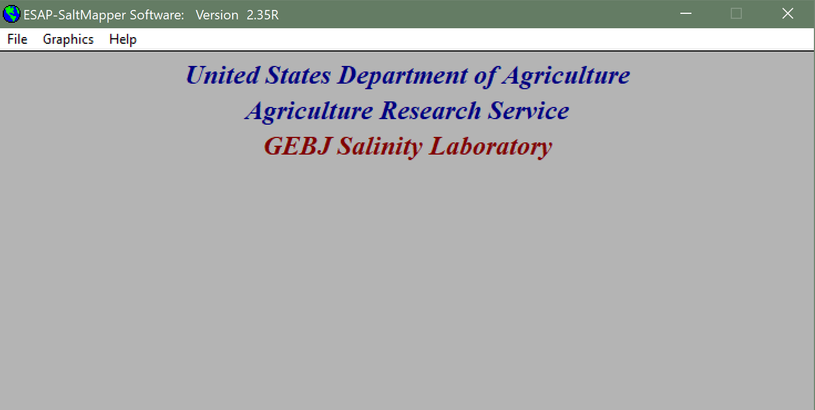
Select Specify/Input File Info from the “File” menu.

Slide 25
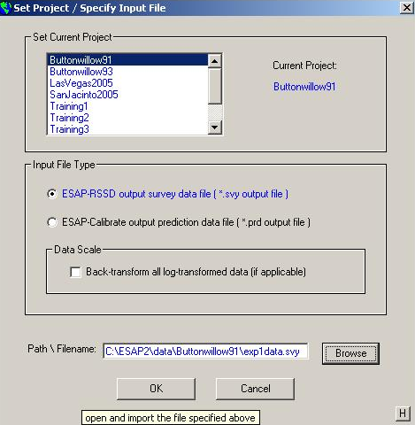
Specify the project and input file location

Slide 26
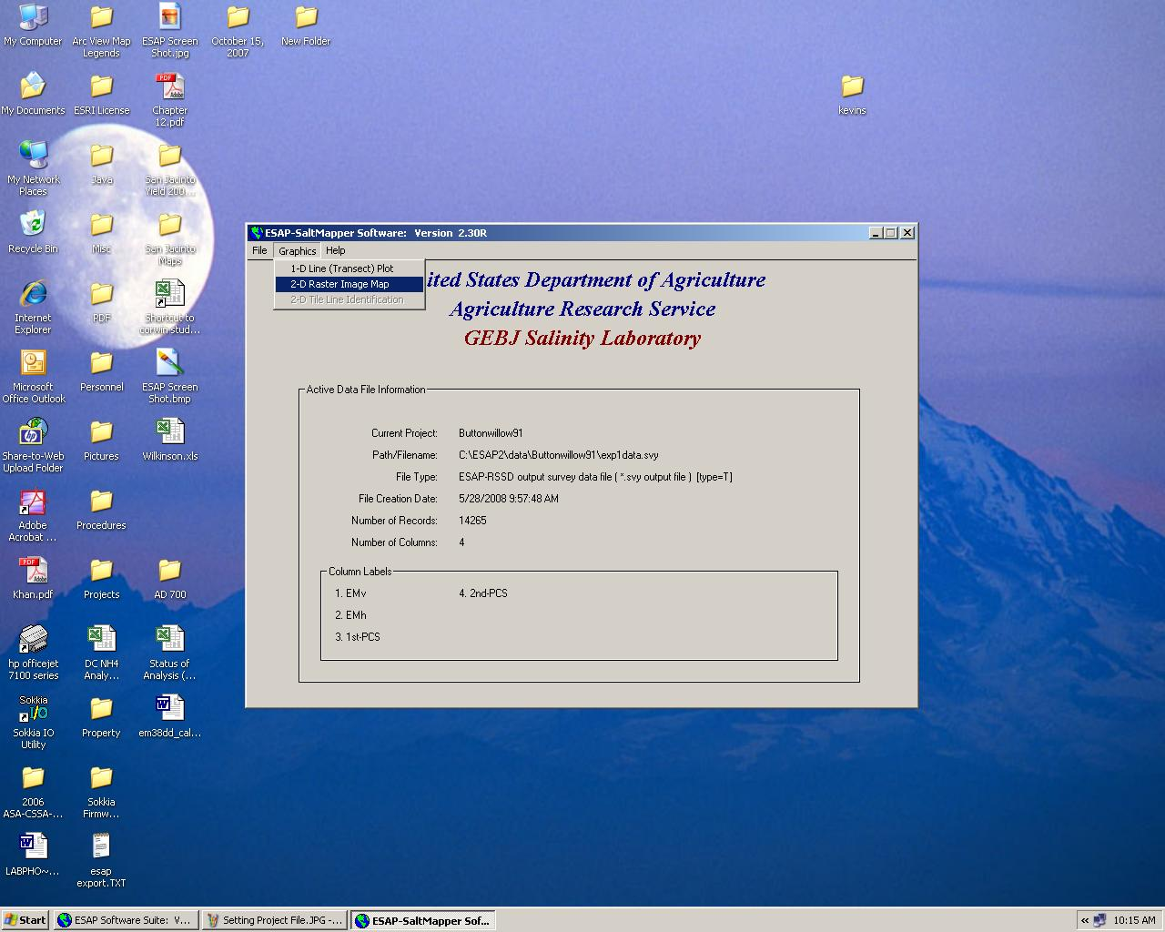
Select 2-D Raster Image Map from “Graphics” menu.

Slide 27
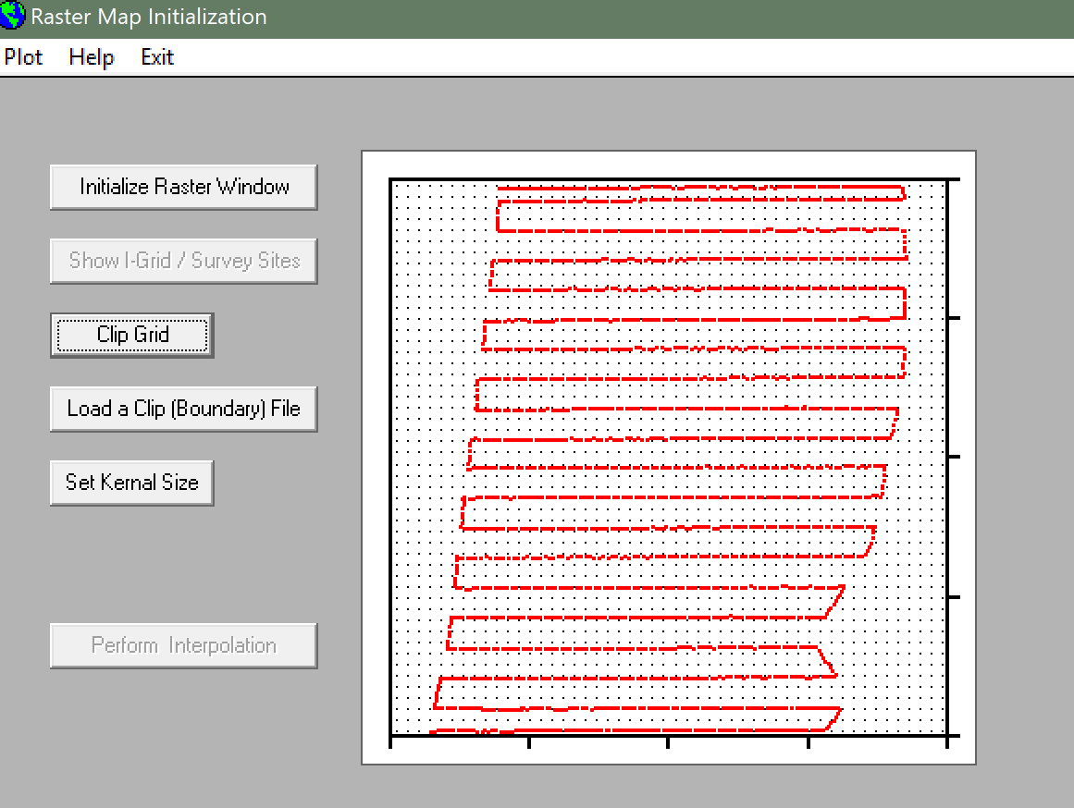
Initialize the Raster Window, then Show the Grid/Survey Sites

Slide 28
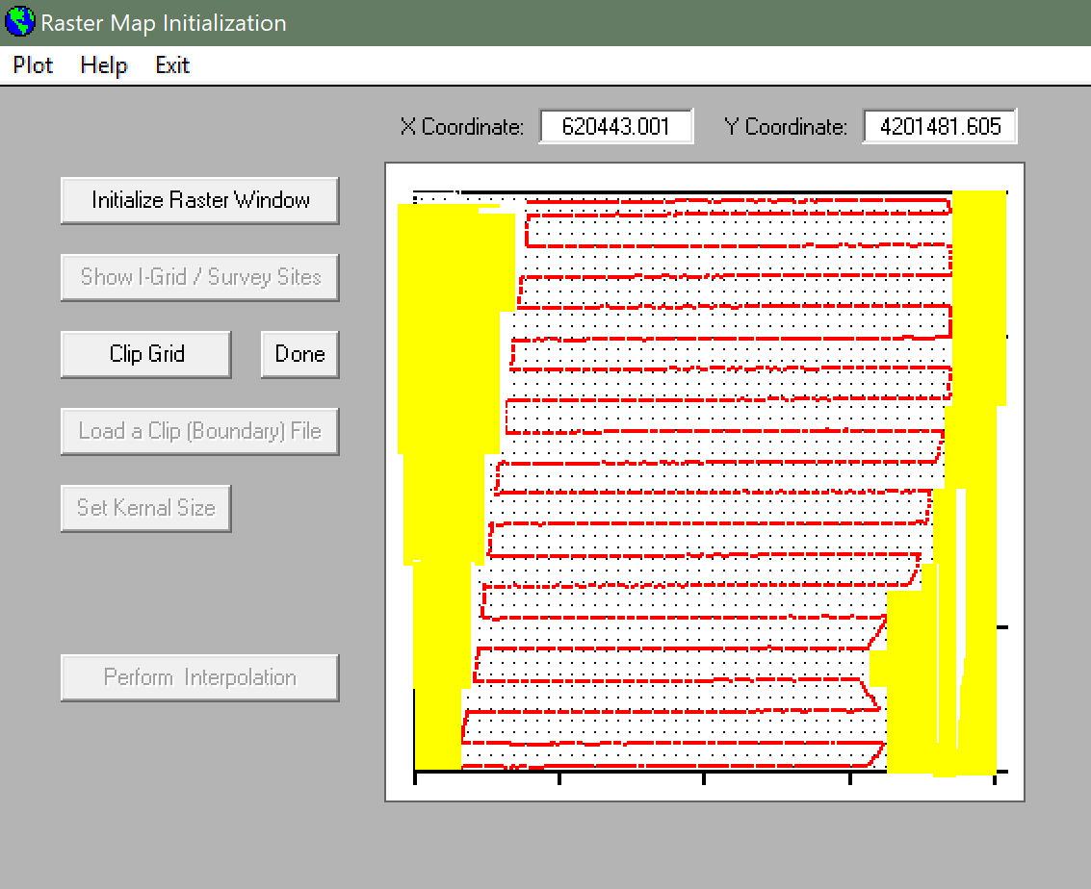
Clip the grid to the appropriate field shape. Yellow indicates clipped area.
Press, “Done”

Slide 29
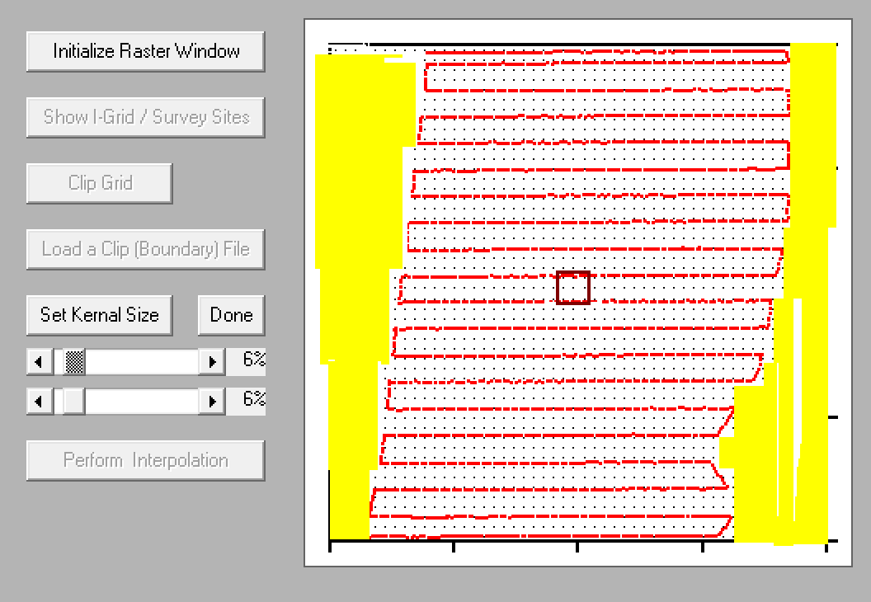
Set the Kernel Size Dense survey grid (6%) Sparse survey grid (10%+)
Press “Done”
Press “Perform Interpolation”

Slide 30
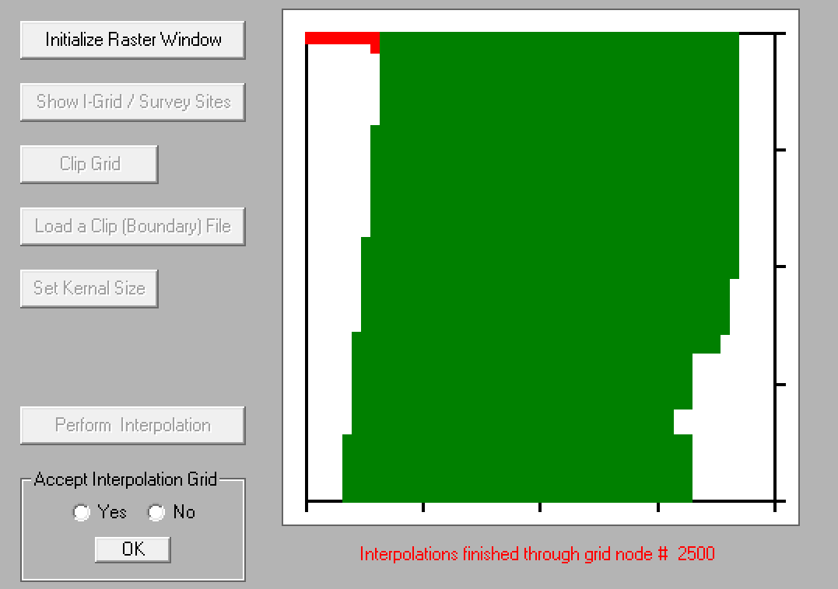
Accept Interpolation Grid After Checking Boundaries

Slide 31
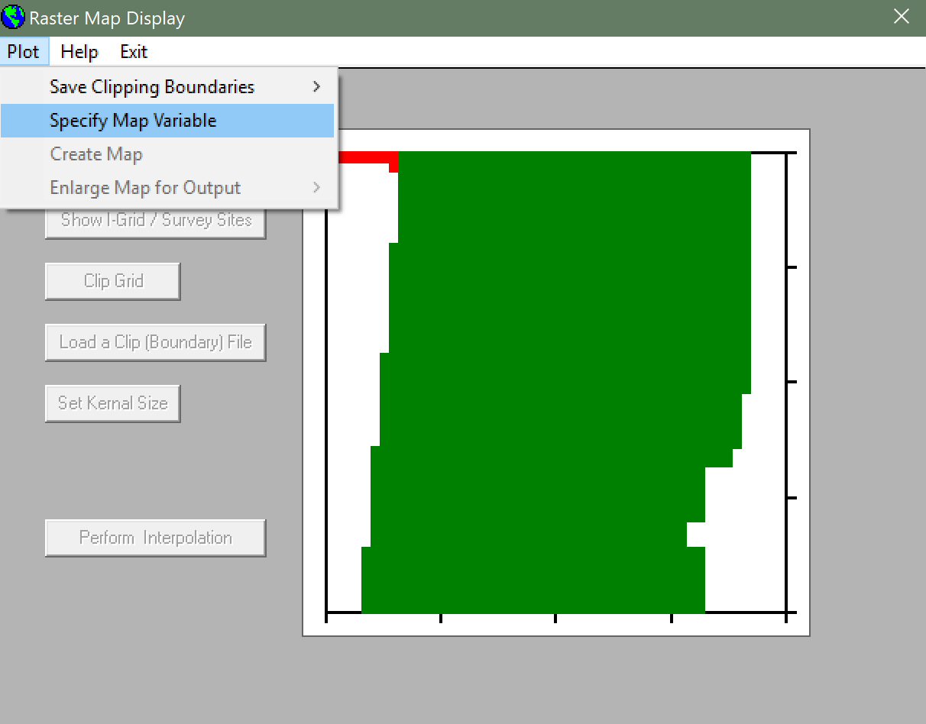
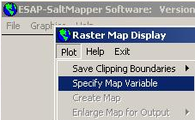
Select Specify Map Variable from the “Plot” menu.

Slide 32
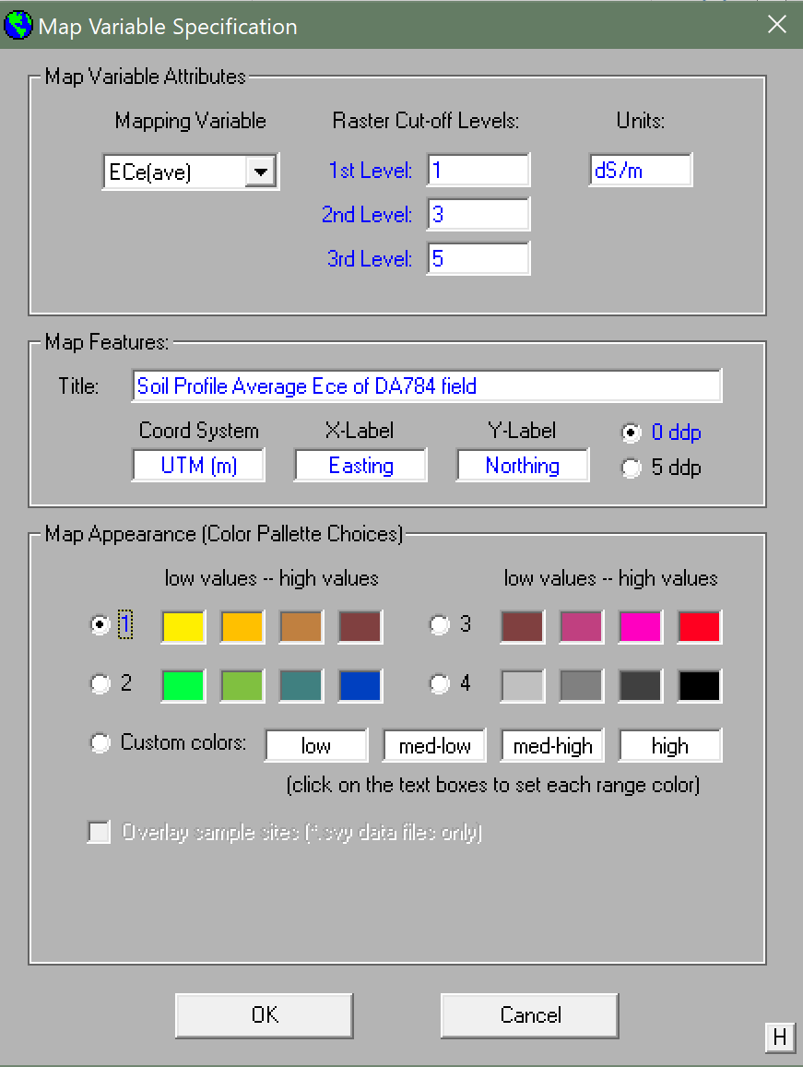
Customize Variable, Map Features, and Map Appearance. Sample sites may also be overlaid.
Press “OK”

Slide 33
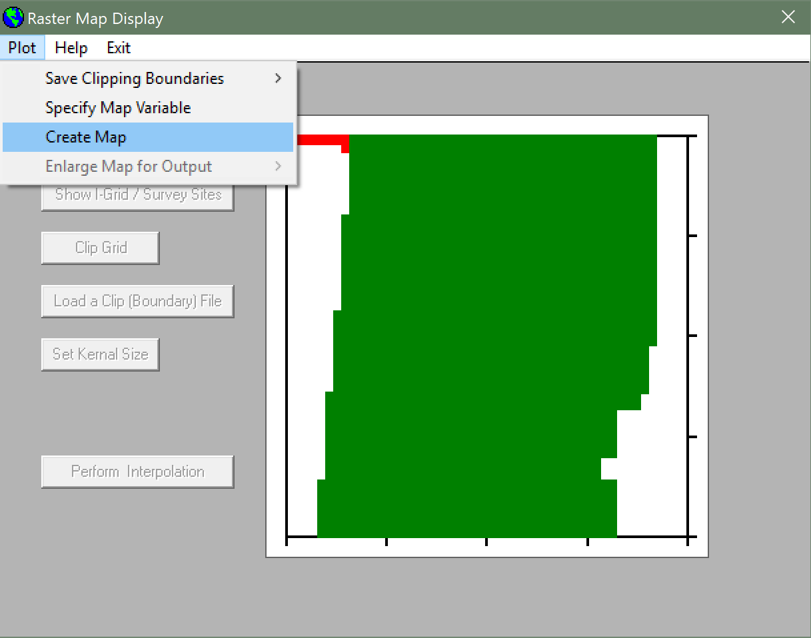
Select Create Map from the “Plot” menu

Slide 34
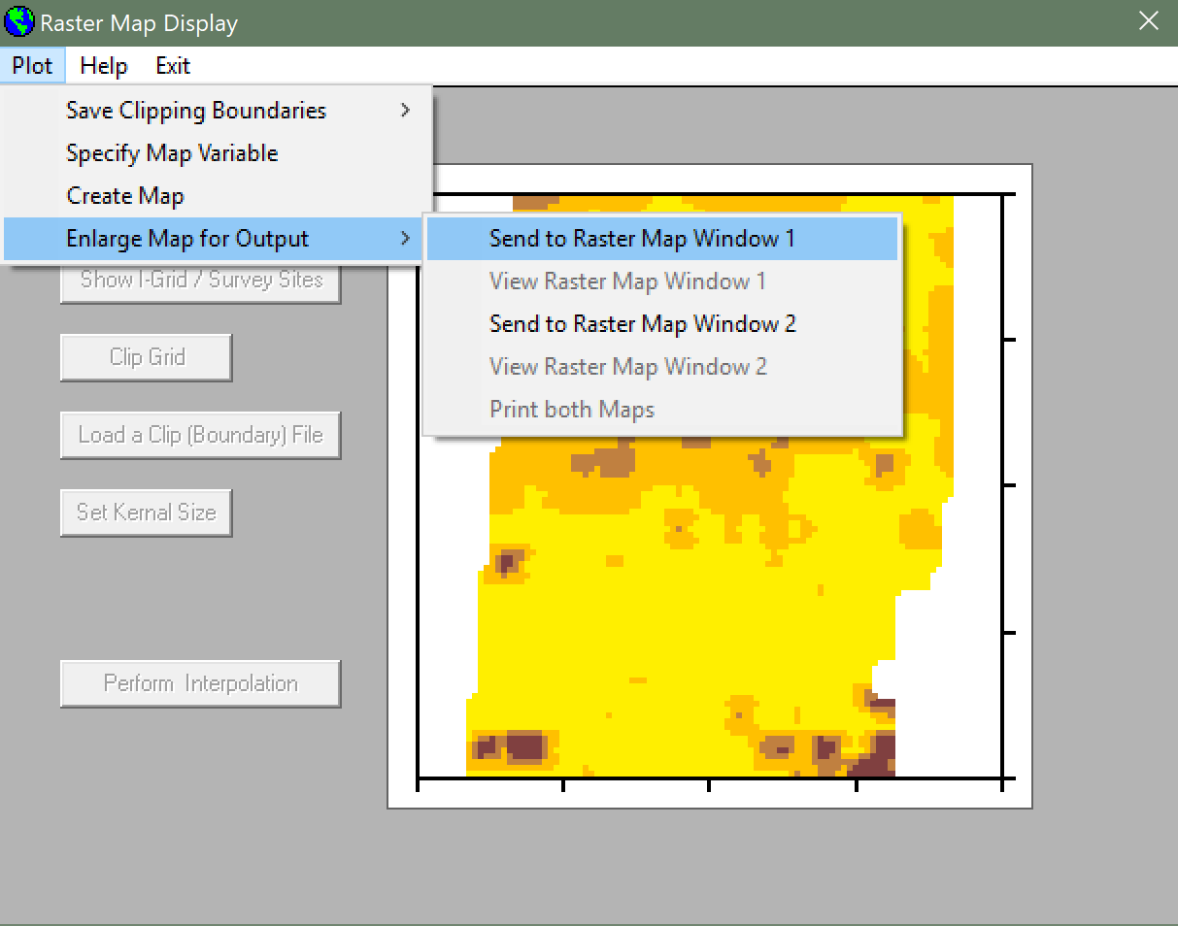
You can now view your salinity map. Select Enlarge Map for Output from the “Plot” menu to view or print your map.

Slide 35
Final Product!

Slide 36

Questions

